Slide 1
Theory: Competition AI is a Weaker Competitor

Slide 2
Source
Attention
Quality
Viewer Recognition
Has AI Answer
Answer Participation
Source
Content Length
Position

Slide 3
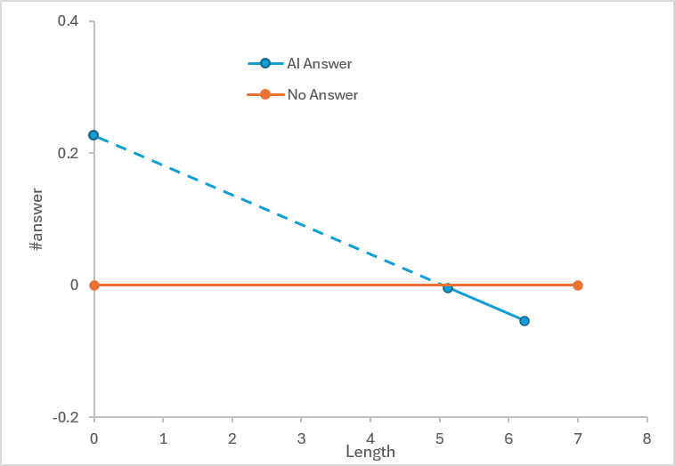
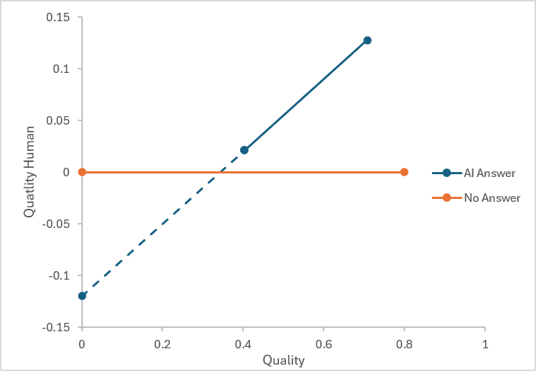
260608 meeting version
Has AI Answer
Answer Participation
Has AI Answer
Answer Innovation
AI Answer Length
AI Answer Quality
Prior Answer Length
Prior Answer Quality
Fast
Slow
Dual Processing

Slide 4
260608 after meeting Ben’s revision
Answer Quality
Has AI Answer
Answer Participation
AI Answer Length
AI Answer Quality
Fast Processing
Slow Processing

Slide 5
Theoretical development solution 1: incorporate Thatcher’s suggestions, posit hypotheses based on existing theories
 | Theoretical Prediction | Which Theory to Use for Arguments | SE suggestion
Stage 1 (Pre-attentive Awareness) | H1a: The mere availability of an AI answer reduces human participation | Public goods theory; crowding-out effect; perceived marginal value reduction | Suggestion 1 (Incentives)
 | H1b: The mere availability of an AI answer has no effect on innovation | No content engagement at the awareness stage; participation decision precedes content influence | -
Stage 2 (Fast Processing) | H2a: The effect of AI answer availability on participation is amplified by AI answer length | ELM peripheral processing; perceived comprehensiveness heuristic; source credibility cues | Suggestion 1 (Incentives)
 | H2b: The effect of AI answer availability on innovation is negatively moderated by AI answer length | Perceived completeness constrains imagined solution space; anchoring narrows divergent thinking | -
Stage 3 (Slow Processing) | H3a: The effect of AI answer availability on participation is amplified by AI answer quality | Source credibility theory; discouragement from high-quality AI output; perceived expertise gap | Suggestion 1 (Incentives); Suggestion 2 (Authority)
 | H3b: The effect of AI answer availability on innovation is positively moderated by AI answer quality | Knowledge complementarity; cognitive stimulation; elaborative processing | Suggestion 3 (Competition)

Slide 6
Theoretical development solution 1: incorporate Thatcher’s suggestions, posit hypotheses based on our results
 | Theoretical Prediction | Which Theory to Use for Arguments | SE suggestion
Stage 1 (Pre-attentive Awareness) | H1a: The mere availability of an AI answer increases human participation | Competitive arousal; identity-based motivation; perceived AI inadequacy for contextual knowledge; question salience signal | Suggestion 1 (Incentives)
 | H1b: The mere availability of an AI answer has no effect on innovation | No content engagement at the awareness stage; competitive arousal affects entry decision but not cognitive resources applied to the answer | -
Stage 2 (Fast Processing) | H2a: The effect of AI answer availability on participation is attenuated by AI answer length | ELM peripheral processing; length as comprehensiveness heuristic; stage-specific authority construction | Suggestion 1 (Incentives) ; Suggestion 2 (Authority)
 | H2b: The effect of AI answer availability on innovation is not moderated by AI answer length | Peripheral cues do not reach content-level processing; no substantive cognitive influence on answer composition | -
Stage 3 (Slow Processing) | H3a: The effect of AI answer availability on participation is not moderated by AI answer quality | Commitment to contribute already formed at Stages 1–2; offsetting discouragement and challenge effects cancel out | Suggestion 1 (Incentives)
 | H3b: The effect of AI answer availability on innovation is positively moderated by AI answer quality | Baseline liberation; constructive divergence; associative activation; strategic differentiation | Suggestion 3 (Competition)

